Slide 1
A Seminar on Secure Health: Dynamic Integrity-Assured Shared EHR Databases with Privacy-Preserving Functional Commitment.
Team Details
Team No-17
1. A.Nagaraju (21EG505803)
2. G.Ramya (21EG505823)
3. M.Keerthana (21EG505847)
Project Supervisor
Mrs.A.Durga Bhavani
Assistant Professor

Slide 2
Introduction
The increasing reliance on Electronic Health Record (EHR) systems, coupled with the rise of resource-constrained IoT devices, demands robust solutions. In response, we propose a Publicly Verifiable Shared Updatable EHR Database Scheme. Unlike existing Verifiable Database (VDB) models, our approach prioritizes real-time proof generation, minimizing user overhead for storage integrity checks. By modifying the Functional Commitment (FC) scheme and incorporating a verifier-local revocation group signature, our scheme ensures privacy preservation, batch integrity checking, and dynamic group member operations. This innovative solution addresses the dual challenges of security and efficiency in EHR systems, contributing to the seamless and secure exchange of sensitive patient information in the digital healthcare landscape.

Slide 3
Problem Statement
In the context of Electronic Health Records (EHR) storage, existing verifiable database (VDB) approaches face challenges in proof reuse and server-driven updates, hindering effective data integrity checks. We propose an innovative updatable VDB scheme based on functional commitment, addressing privacy-preserving integrity auditing and group member operations. Our scheme prioritizes server response correctness and data storage integrity, aiming for security without excessive computational overhead. We design an updatable functional commitment scheme and present a practical VDB scheme under computational assumptions. Batch auditing enhances efficiency in multi-cloud, multi-user scenarios. Theoretical proofs affirm desired security properties, with our scheme outperforming alternative algorithms
• Existing Method Disadvantages:
1. The primary challenge in EHR systems lies in ensuring real-time verification of server responses.
2.The existing VLR group signature scheme does not have backward unlinkability (BU), which means that even if a member is revoked at a certain time, the signature before that time remains anonymous. It poses a threat to user identity privacy.

Slide 4
Problem Illustration
The verifiable database (VDB) as a secure and efficient updatable cloud storage model for resource-limited users. In a VDB scheme, a client can outsource the storage of a collection of data items to an untrusted server. Later, the client can query the server for an item (a message) at position i, the server returns the stored message at this position along with a proof that it is the correct answer. However, the security of only verifying the server response correctness is far from enough for the EHR system, and it is not clear whether data that is not fre-quently accessed is still stored correctly. If these data are destroyed and not discovered in time, it can cause huge losses in the event of an emergency.

Slide 5
Proposed Method
Focusing on secure and efficient storage, emphasizing server response correctness and data storage integrity for Electronic Health Records (EHR). Utilizes functional commitment (FC) to design a publicly verifiable updatable database scheme, addressing privacy-preserving integrity auditing and dynamic group operations. Enhances an existing FC scheme for an auditable Verifiable Database (VDB) scheme, proposing an efficient, publicly verifiable updatable VDB with minimal computational overhead and storage costs. Applicable for large-scale data storage, ensuring minimum user communication cost. Preserves original VDB scheme properties while achieving efficient privacy features and auditability.

Slide 6
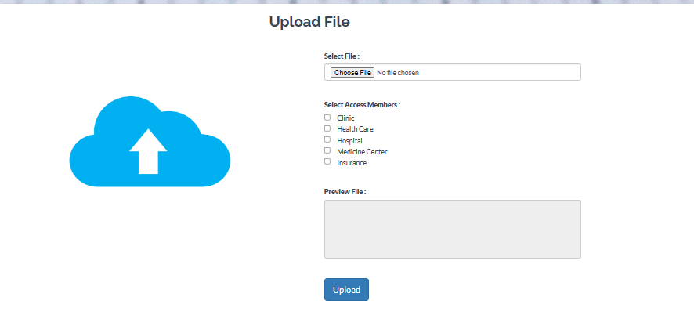
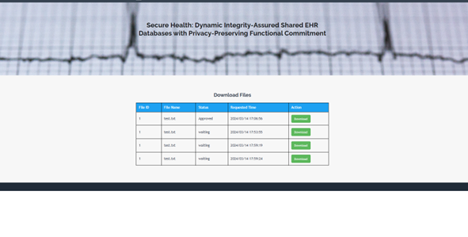
Proposed Method Illustration

Slide 7
Experiment Environment
Tools:
NetBeans
MySql
DriveHQ
Language:
Java

Slide 8
Experiment Environment
NetBeans: NetBeans is an open-source IDE designed for Java development, also supporting HTML, PHP, and C++. With a user-friendly interface, it offers tools for coding, debugging, and GUI design. Its modular architecture allows easy plugin integration, and it supports version control systems like Git for collaborative development. NetBeans stands out with features like intelligent code completion, generation, and a variety of plugins, making it a versatile choice for developers across multiple languages.
MySQL:MySQL is a widely used relational database management system (RDBMS). MySQL is free and open-source. MySQL is ideal for both small and large applications.
DriveHQ :DriveHQ has many powerful browser-based features: You can drag-n-drop upload files from your PC to a cloud folder; you can easily access, manage, share or publish files from anywhere; and it supports flash / HTML5-based batch file uploader.

Slide 9
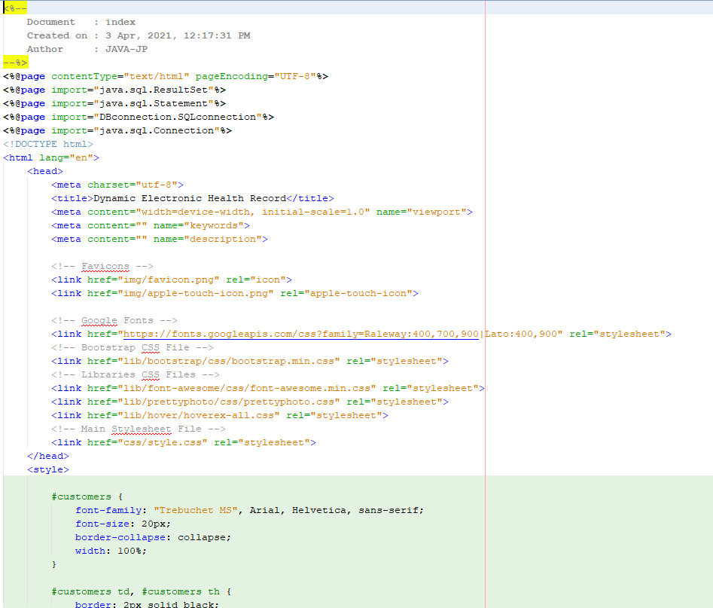
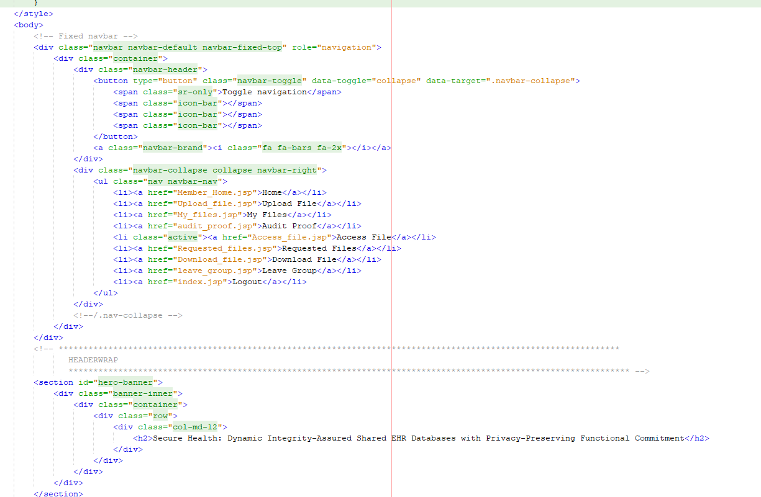
Experiment Screenshots
Access files

Slide 10
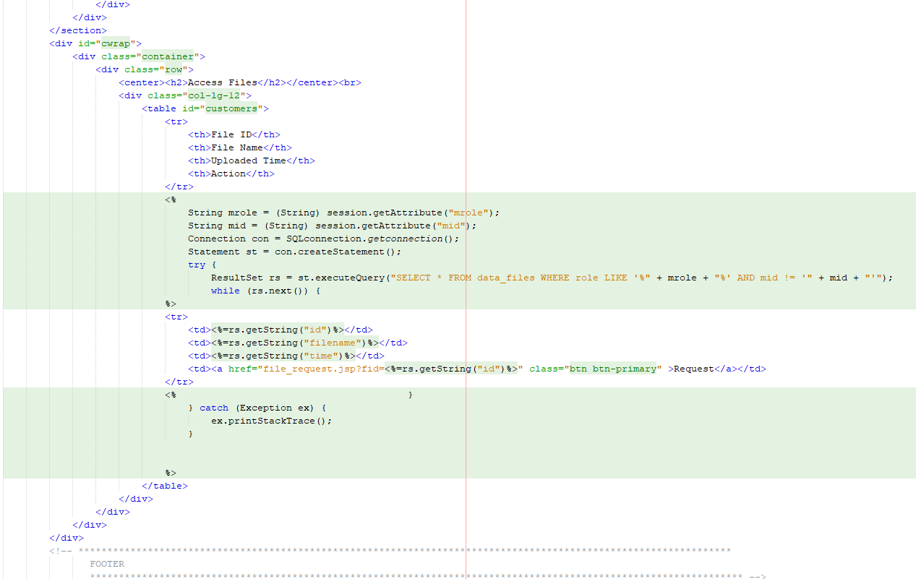
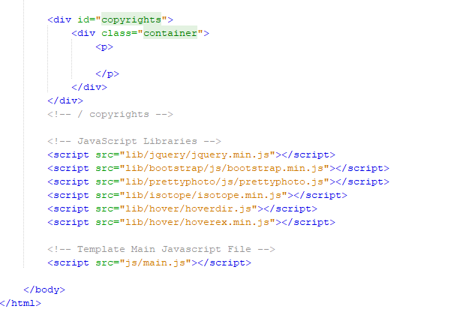
Experiment Screenshots

Slide 11
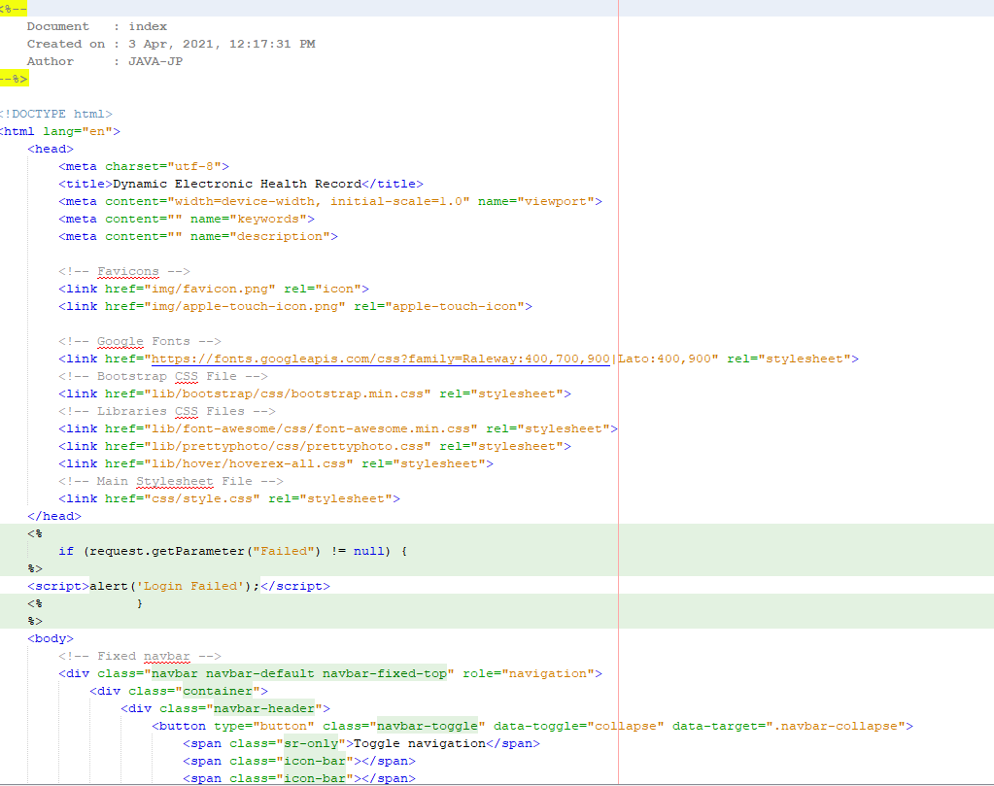
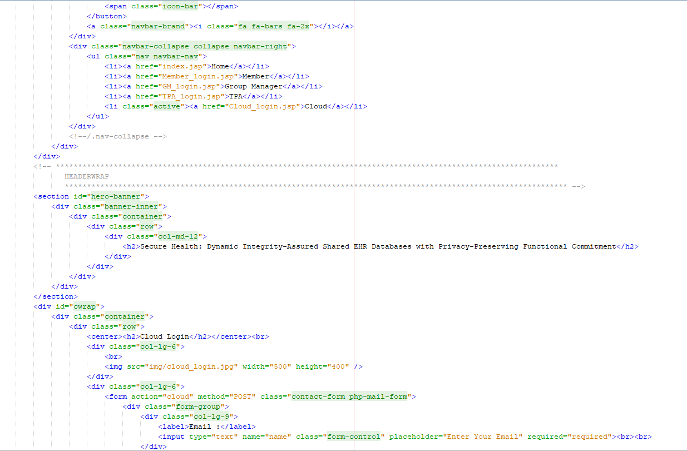
Experiment Screenshots
Cloud login

Slide 12
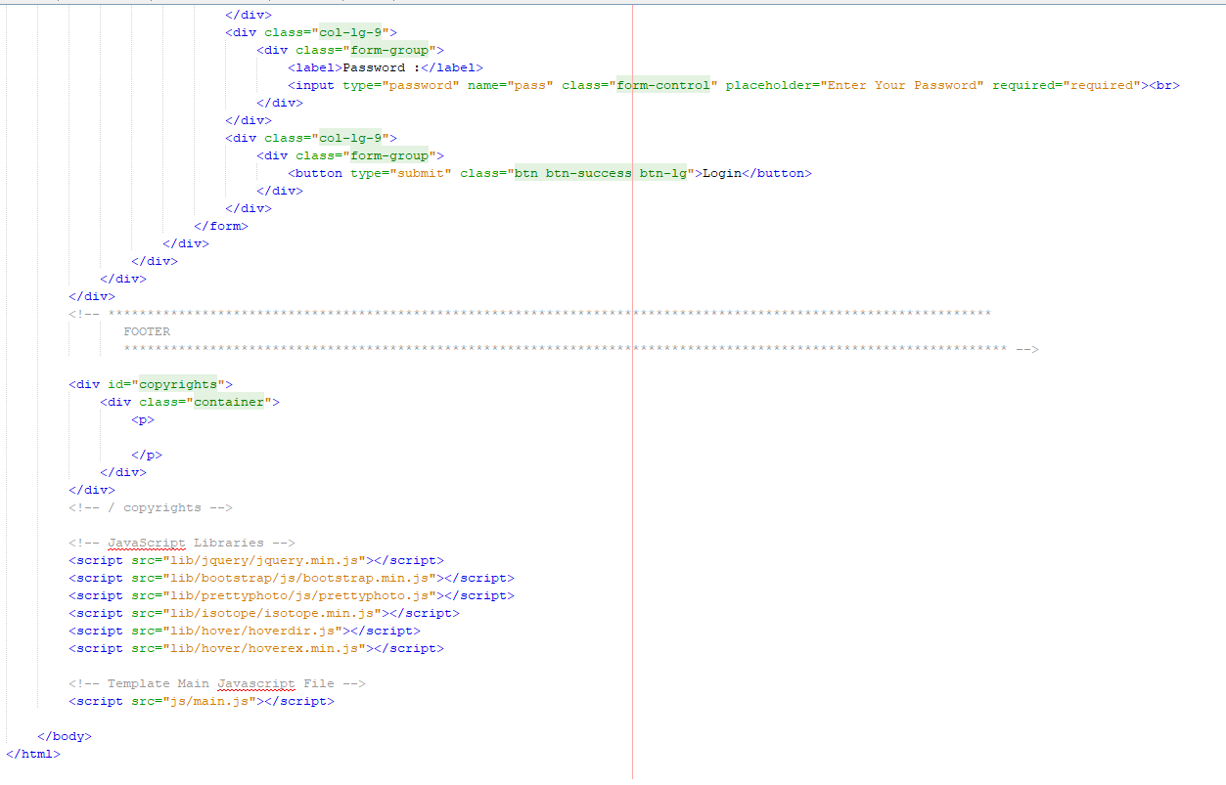
Experiment Screenshots

Slide 13
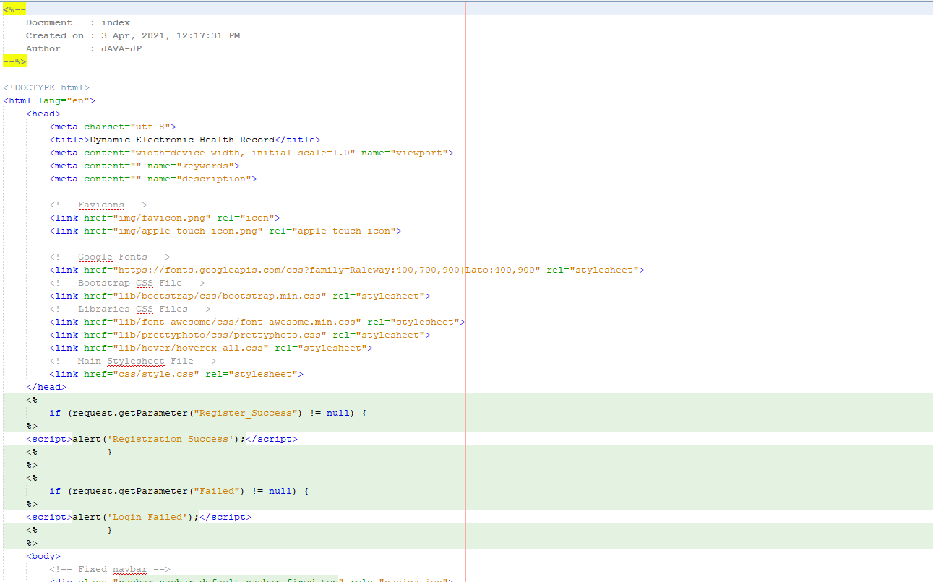
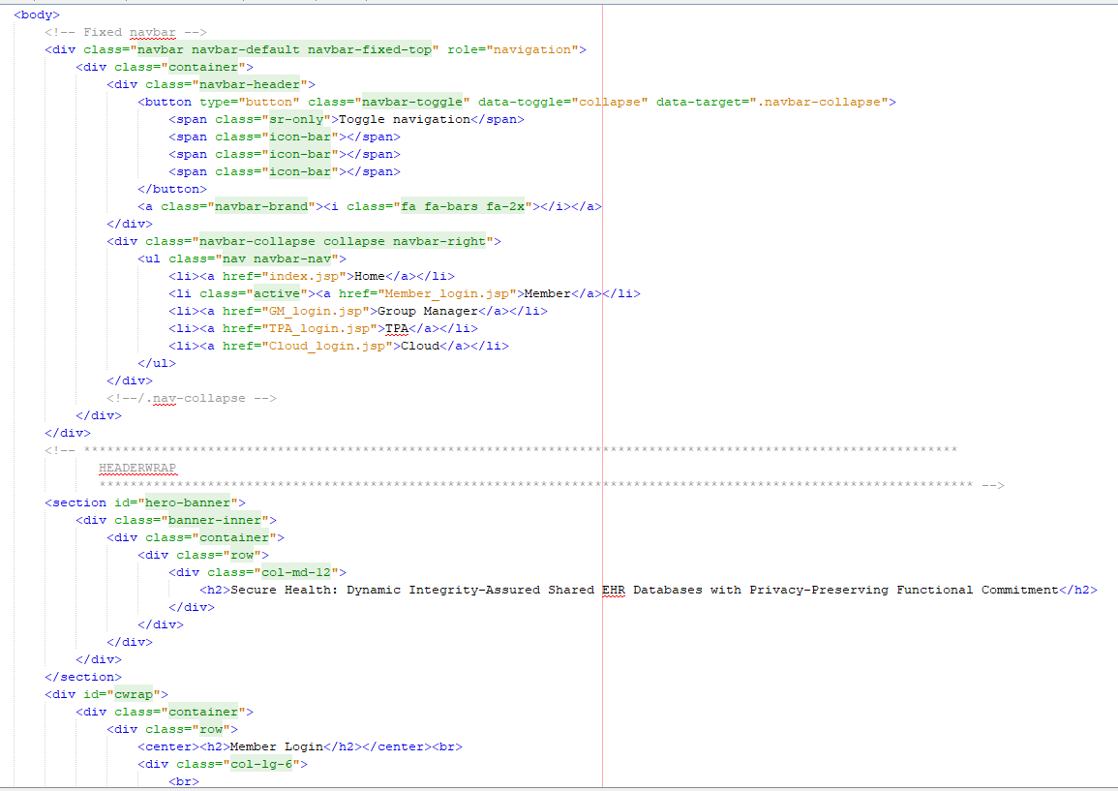
Experiment Screenshots
Member Login

Slide 14
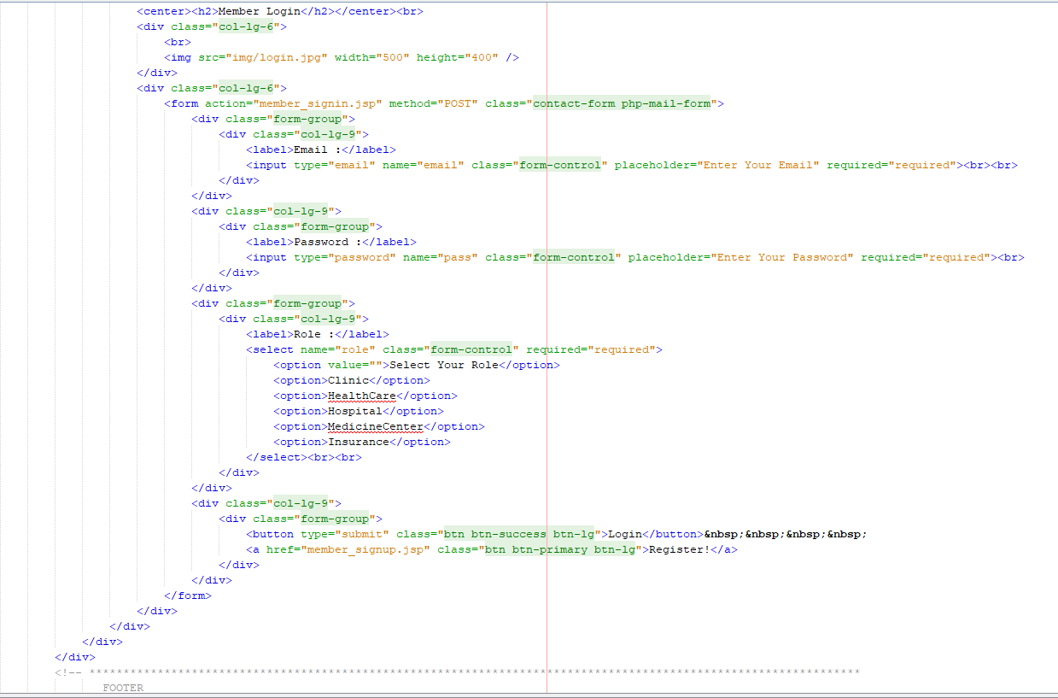
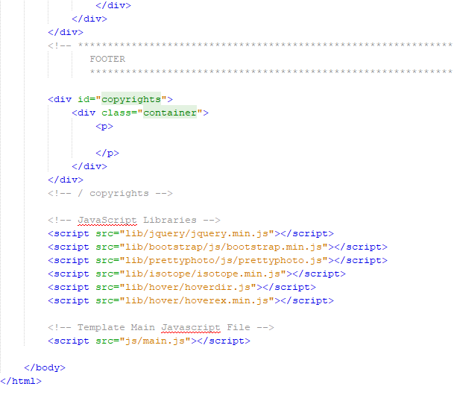
Experiment Screenshots

Slide 15
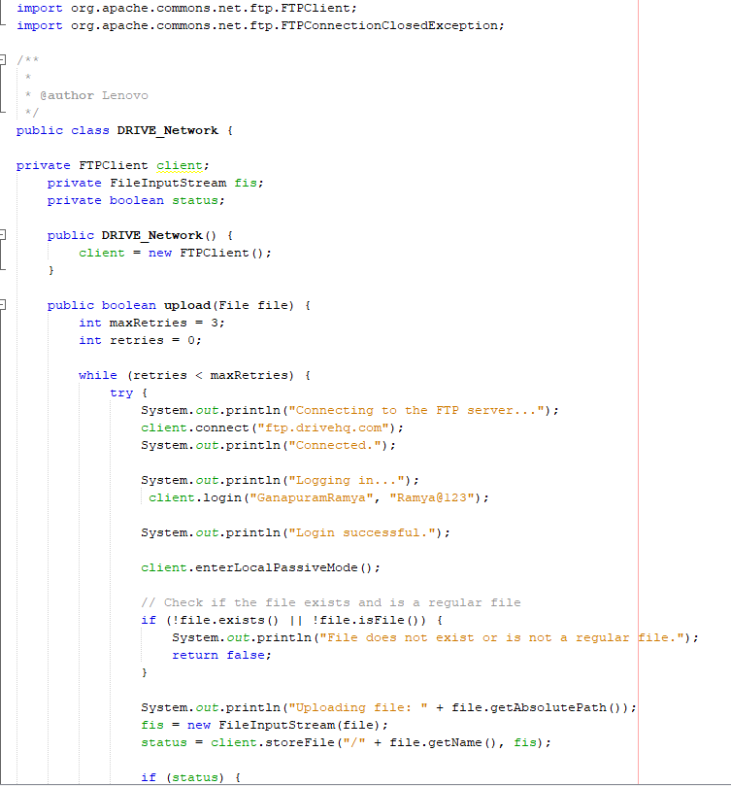
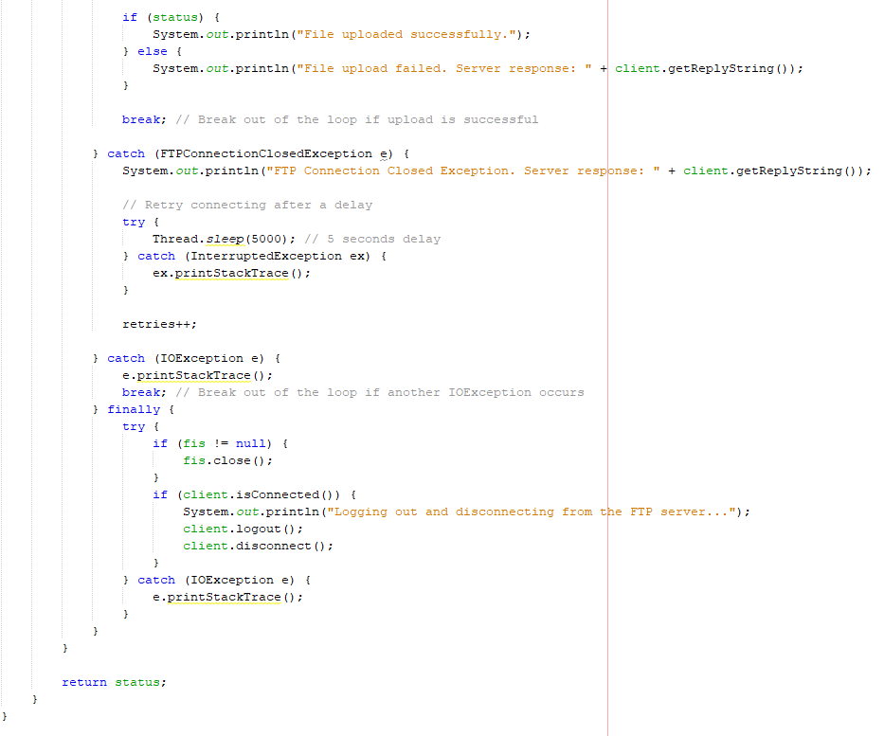
Experiment Screenshots
DriveHq

Slide 16
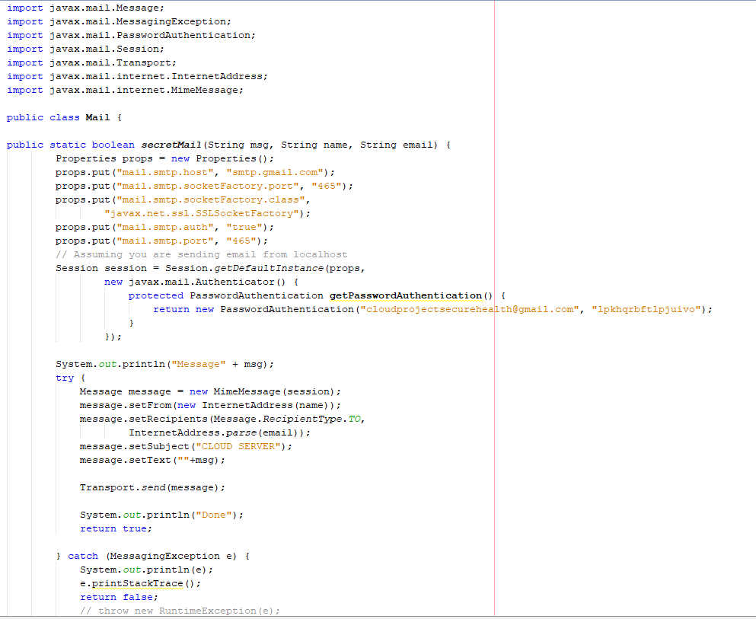
Experiment Screenshots
Mail connection

Slide 17
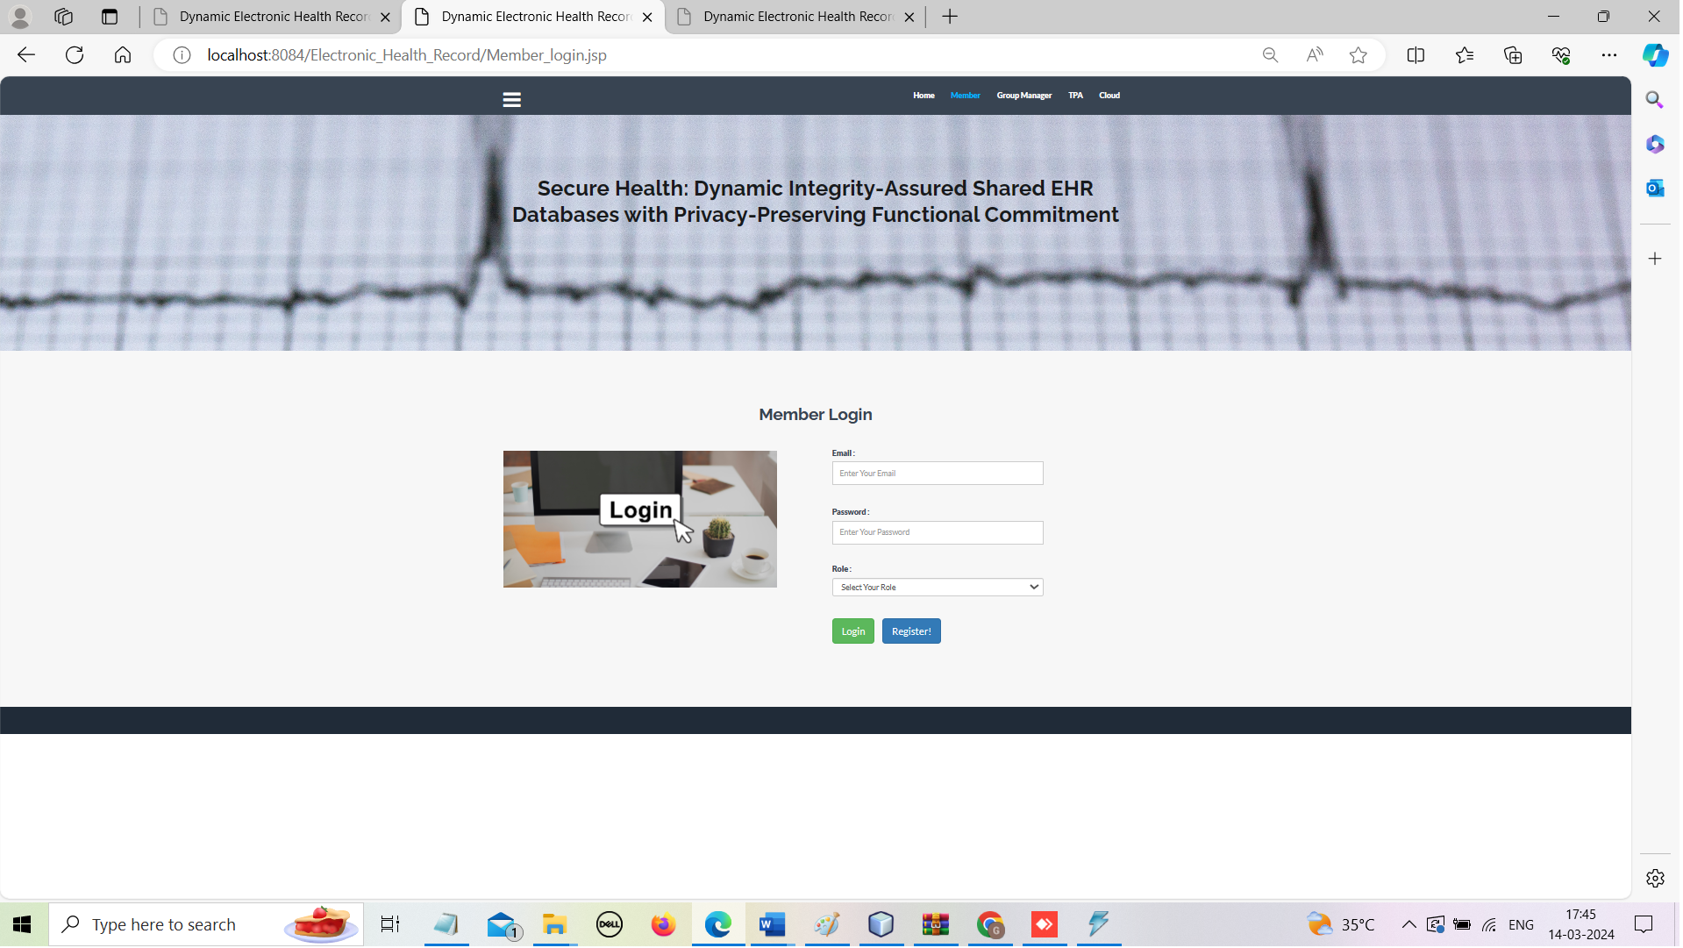
Experiment Results

Slide 18
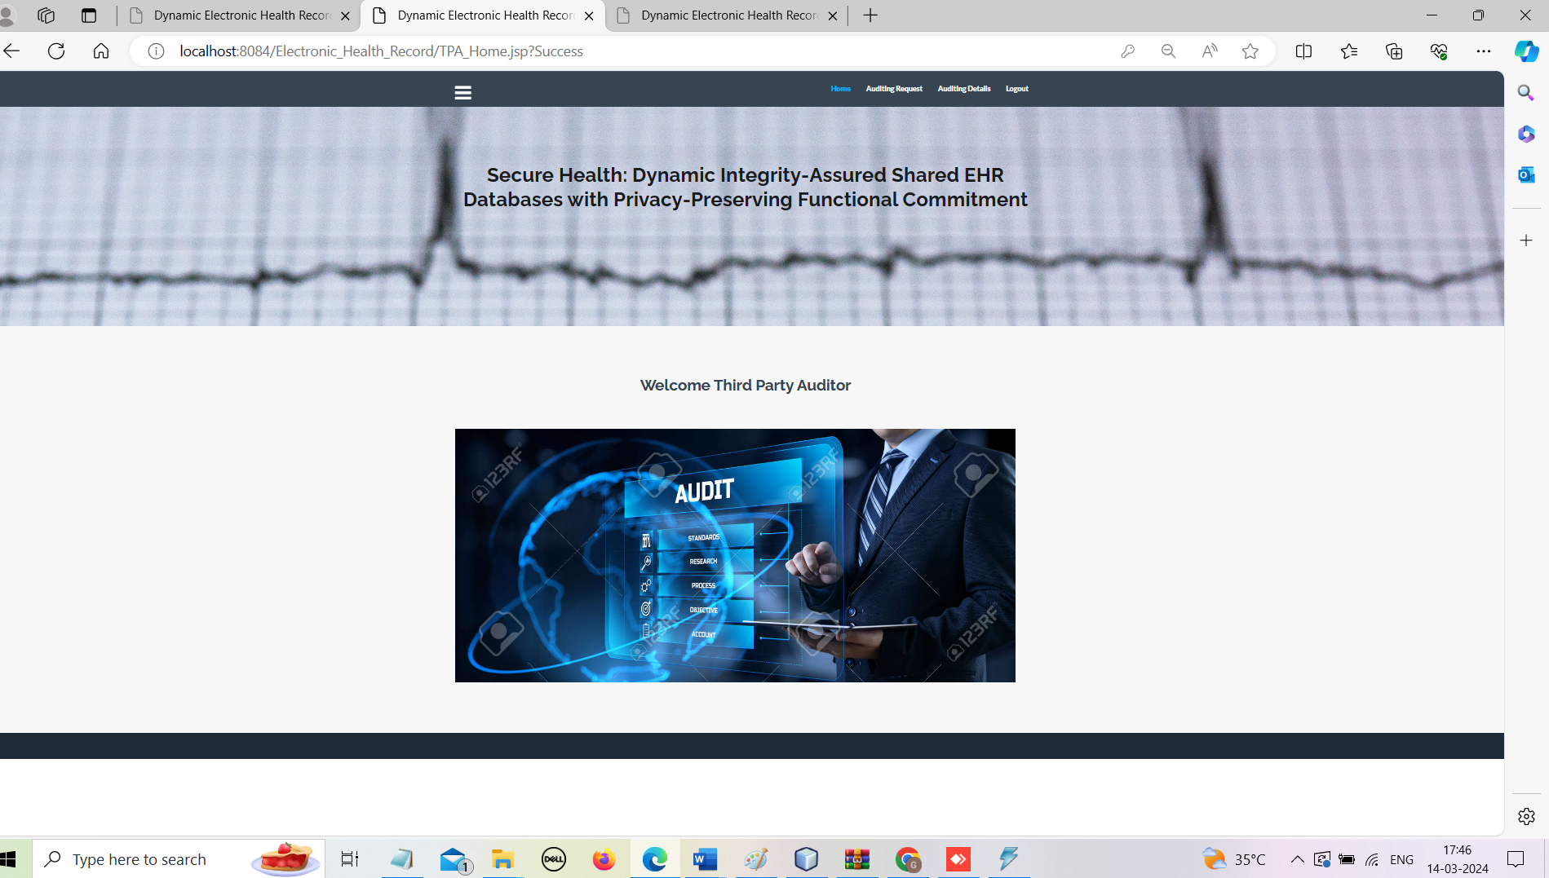
Experiment Results

Slide 19
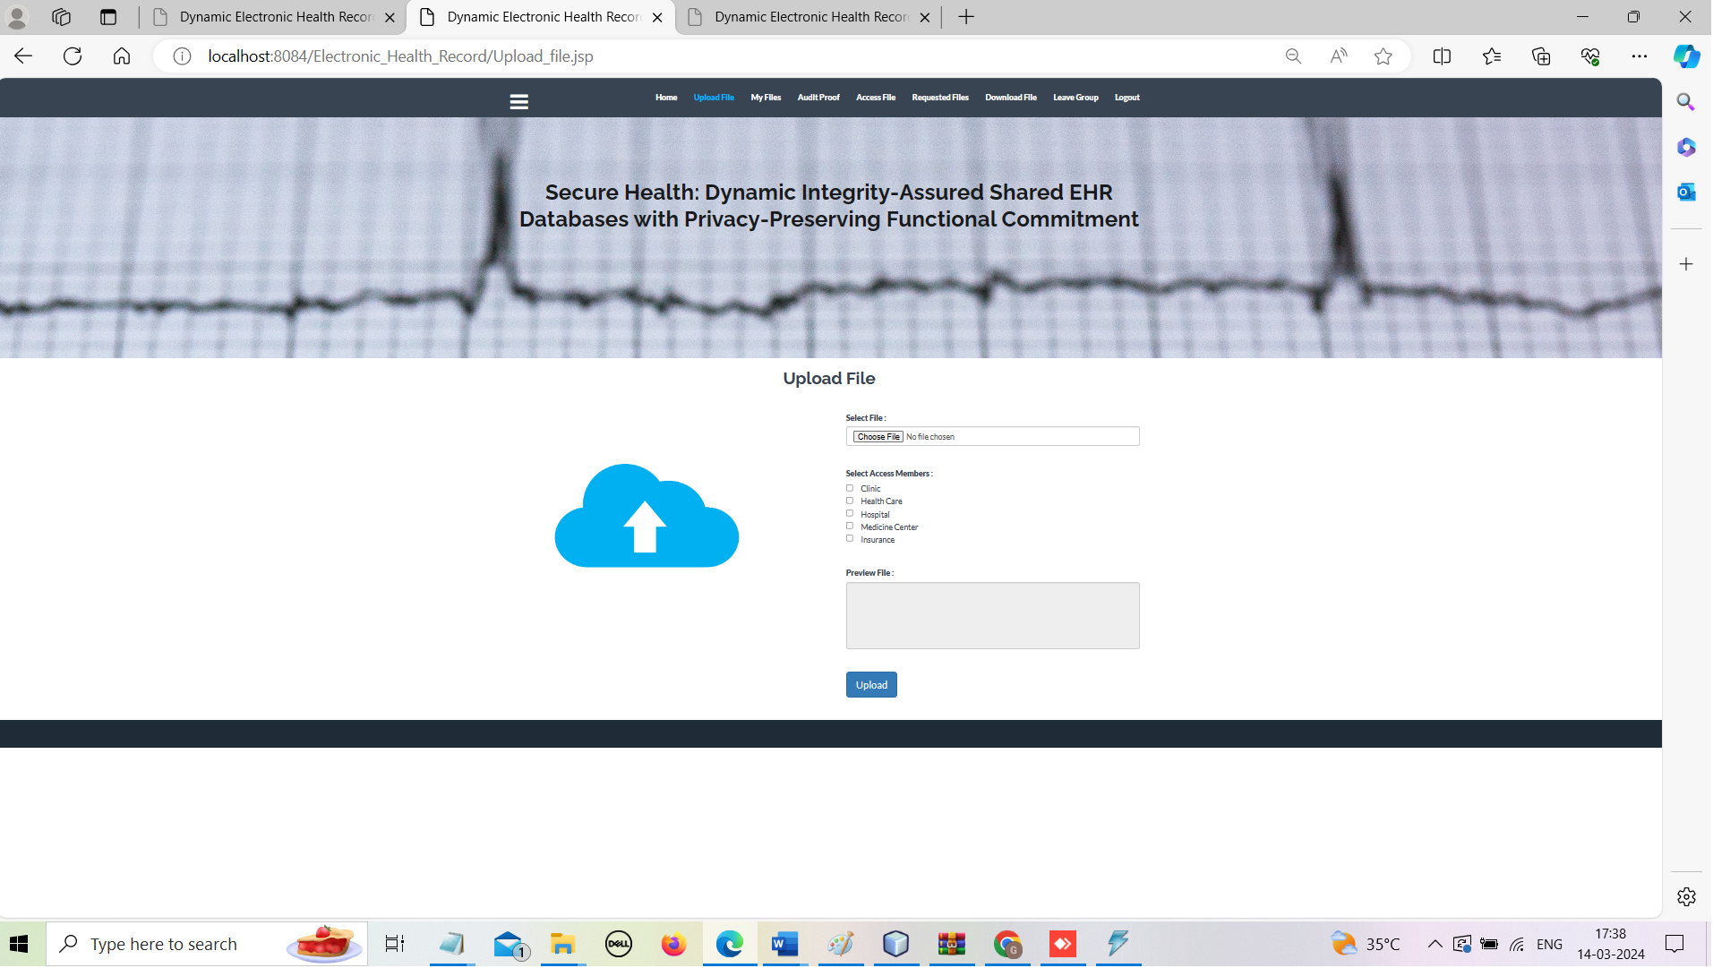
Experiment Results

Slide 20
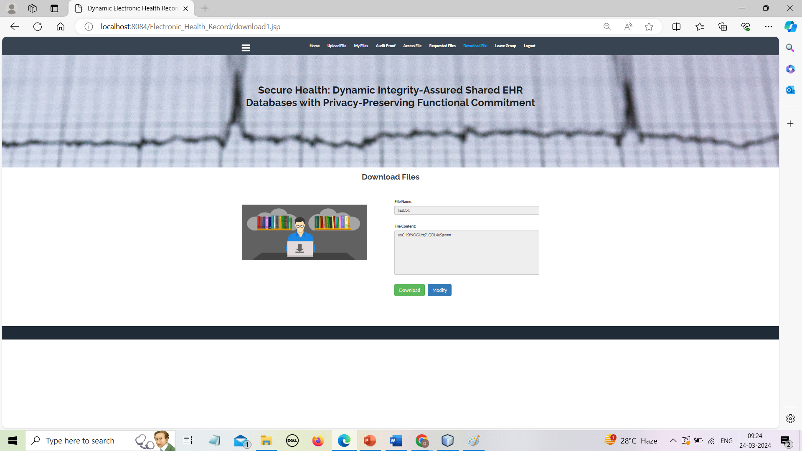
Experiment Results

Slide 21
Finding
The concept of verifiable database is a great tool for verifiable EHR storage. However, proof reuse and the technique of proof updating by the server to improve system efficiency fails to achieve data integrity checking. In this work, we propose a novel updatable VDB scheme based on the functional commitment that supports privacy-preserving integrity auditing and group member operations, including join and revocation. Two security requirements of HER are implemented: the server response correctness and the data storage integrity. Our VDB scheme achieves the desired security goals without incurring too much computational increase. And our VDB scheme provides the minimum communication cost for the terminal with limited performance. To design a functional commitment scheme that applies to our program, two algorithms are added to make the FC scheme updatable. A practical improved concrete VDB scheme under computational l −BDHE assumption is presented. In addition, batch auditing for our VDB scheme supports multi-cloud server, multi-user and multi-storage vector scenarios. It makes the auditing process more efficient. Furthermore, we prove that our functional commitment scheme with updates and our VDB scheme can achieve the desired security properties. The performance of our scheme is more efficient compared with other different algorithms.

Slide 22
Justification
The scheme preserves data privacy from the auditor by using a random masking technique and the sparse vector is used for sampling auditing.
Our scheme supports dynamic group member operations which include join and revocation. In addition, our VDB supports batch auditing and it supports multi-cloud server, multiuser and multi-storage vector scenarios.
Security analysis and experimental comparison with existing schemes are provided and it shows that our VDB is secure and efficient.
Our VDB scheme can securely and efficiently query and update database stored in the cloud and publicly audit data storage integrity

Slide 23
Thank You

